Slide 1
Geospatial Binary Forecasting of Wildfires in California: Time Series Analysis with Climate Data
Guided by : Prof. Michael Mann
Instructor : Prof. Abdi Awl
Teammates:
Sai Narayana Murthy Dontukurti
Sasank Reddy Chaganti

Slide 2
Introduction
In recent years, California has experienced some of the most destructive wildfires in its history. The escalation in wildfire frequency, intensity, and duration is becoming a critical concern, with significant implications for public safety, ecological health, and economic stability.
Challenges in wildfire prediction stem from the dynamic interplay of climate factors and geographic variables. Accurately integrating diverse data sets, including temperature, precipitation, and spatial information, is critical for developing reliable predictive models.

Slide 3
Why does it matter?
Public Safety and Disaster Management
Ecological and Economic Impacts
Policy Making and Climate Adaptation
Innovation in Environmental Management

Slide 4
Literature Review
Study on Environmental Triggers and Wildfire Occurrences: Reference: Journal.pone.0254723 Key Findings: Investigates the correlation between various environmental triggers and the frequency of wildfires. Highlights how specific climate conditions can significantly increase wildfire risks. Relevance: Supports the use of climate data in our predictive modeling, underscoring the importance of including environmental factors in wildfire forecasts.
Analysis of Wildfire Spread and Containment Strategies:Reference: Journal.pone.0153589. Key Findings: Examines the effectiveness of different wildfire containment strategies and their impact on the speed and direction of fire spread. Relevance: Provides a basis for integrating containment strategies into our models, allowing for more dynamic and responsive wildfire management and prediction.

Slide 5
About the Data
Climate Data Overview: Utilizes a decade of annual temperature and precipitation data sourced from the PRISM Climate Group to capture climatic variations and trends.
Fire Perimeter Data: Employs geo-referenced fire perimeter data in .geojson format from CAL FIRE, which maps the historical extents of wildfires across California.
Sampling Strategy: Implements a strategic approach to select random points across the integrated dataset for each year, aiming to create a balanced and representative CSV dataset for analysis.
Data Preparation for Analysis: The process involves integrating climate and fire perimeter data, followed by sampling to generate a CSV. This dataset will be foundational for exploratory data analysis (EDA), feature engineering, and model development.

Slide 6
Data Processing
.bil to .tif Conversion:The initial climate data was received in .bil format, which necessitates conversion to .tif (Tagged Image File Format) for enhanced compatibility with GIS and remote sensing software. This step ensures broader accessibility and usability of the data for geospatial analysis.
Utilization of xr_fresh: Employed xr_fresh, a specialized library, for efficient processing and extraction of time series features from the climate data. This choice was driven by xr_fresh's capability to handle complex climatic datasets, simplifying the feature engineering process.
Selection of Time Series Features: Based on the dataset and project requirements, 12 key time series features were identified for analysis. These features were selected to capture the essential temporal patterns and anomalies in temperature and precipitation data relevant to wildfire prediction.

Slide 7
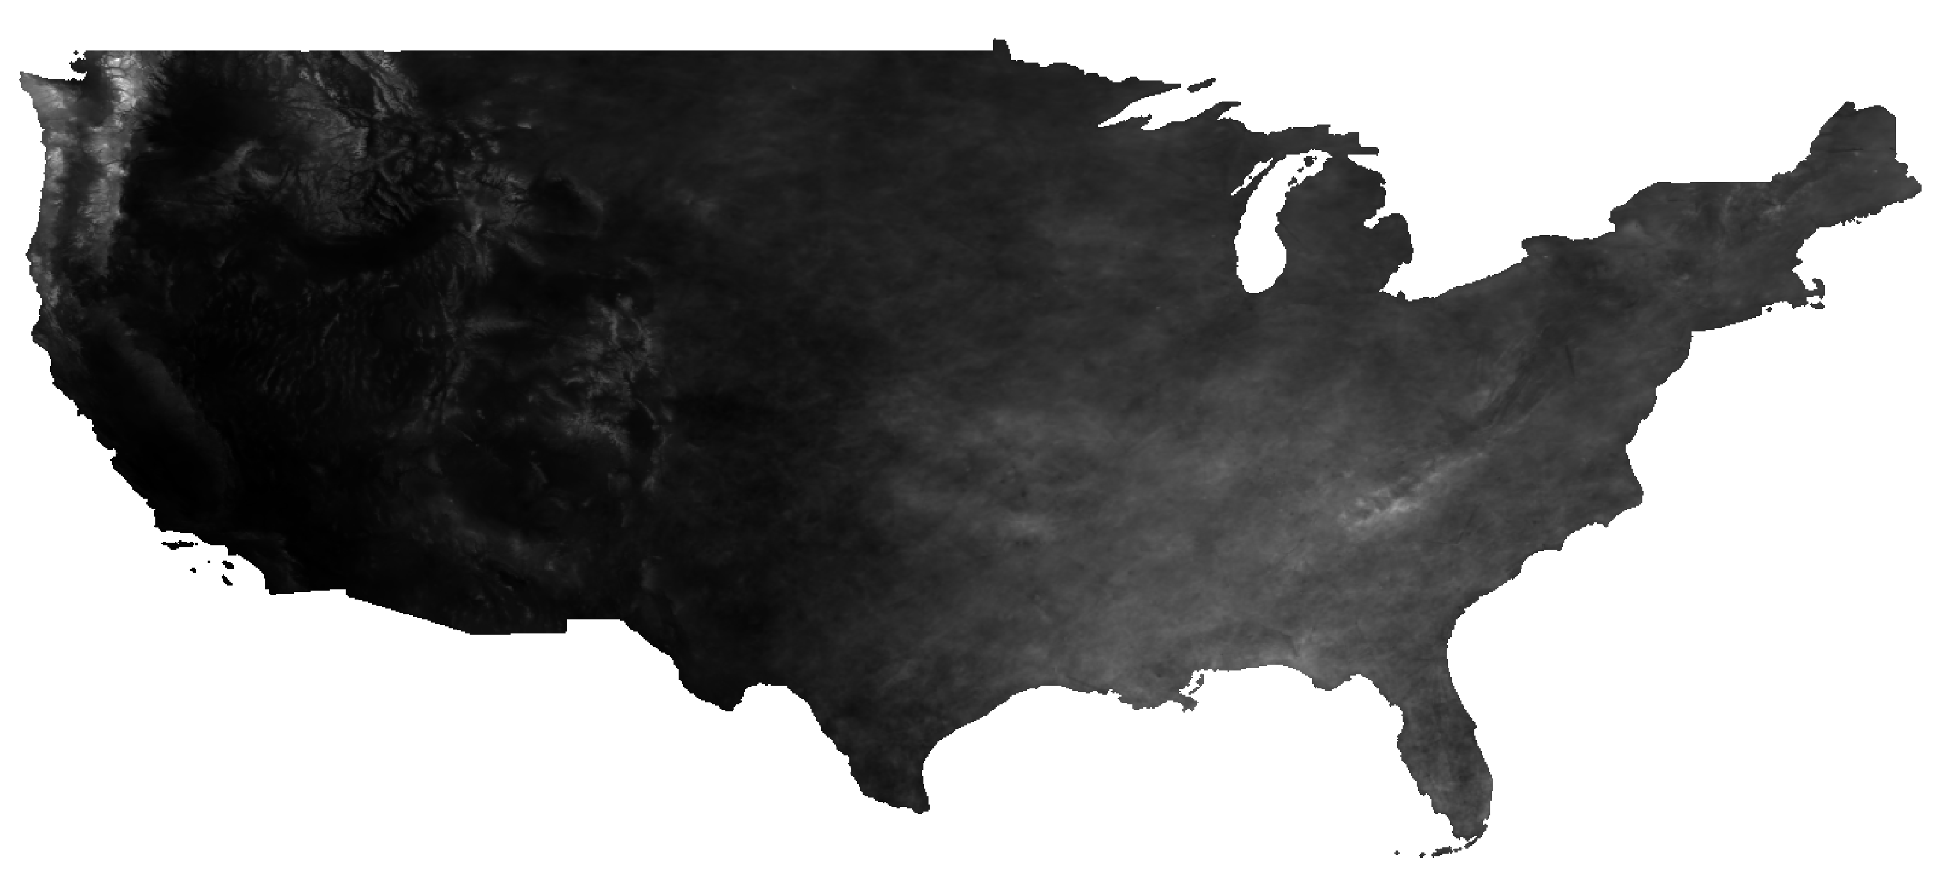
Mean_ppt for single year time series feature:

Slide 8
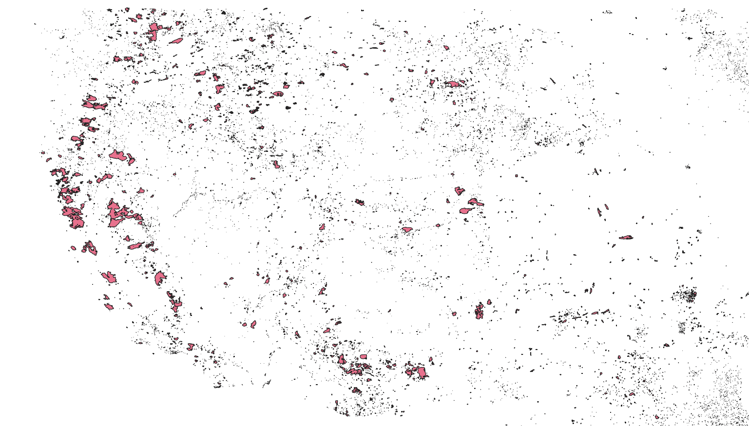
Before rasterizing the fire perimeter data

Slide 9

Why to rasterize the data
Compatibility with Climate Data: Our project utilizes climate data (temperature and precipitation) that is already in a raster format. Rasterizing fire perimeter data ensures uniformity, allowing for direct comparison and overlay analysis with climate data layers.
Spatial Analysis and Modeling: Raster data is particularly useful for environmental modeling and spatial analysis. By converting fire perimeters into raster format, you can perform detailed spatial analyses to identify patterns and correlations between wildfire occurrences and climatic conditions.
Simplification and Scalability: Working with raster data can simplify the analysis. It allows for the application of a wide range of GIS tools and techniques that are optimized for raster data, enabling efficient processing and analysis of large datasets.
Quantitative Analysis: Rasterizing enables the quantification of areas affected by wildfires and the assessment of their impact in relation to various climatic factors. This quantitative approach is essential for building predictive models and conducting risk assessments.

Slide 10

Data Pre-processing:
Extracted from satellite images using advanced geospatial techniques.
Time Span: Decade-long dataset covering the years 2013 to 2023.
Dataset Dimensions: Comprises approximately 75,000 rows and 277 columns.
Time Series Features: Includes precipitation (ppt) and maximum temperature (tmax).
Geographic Locations: Data on specific locations to analyze spatial distribution.
Target Variable: Presence of wildfires, indicating whether a fire has occurred or not.
Purpose of the Data: To enable comprehensive analysis of wildfire trends and prediction using time series and spatial data.

Slide 11
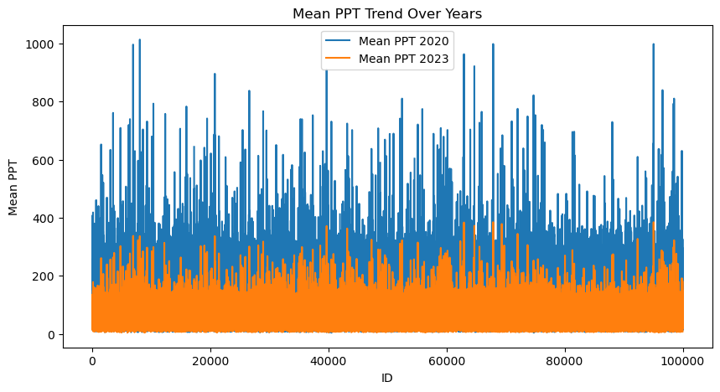
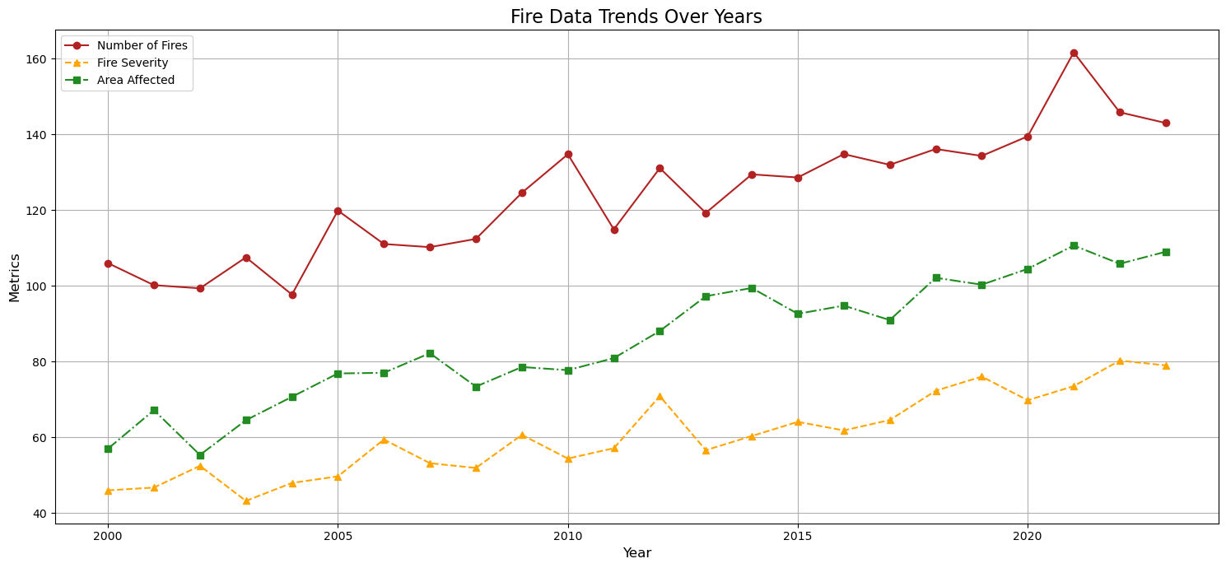
Exploratory Data Analysis

Slide 12
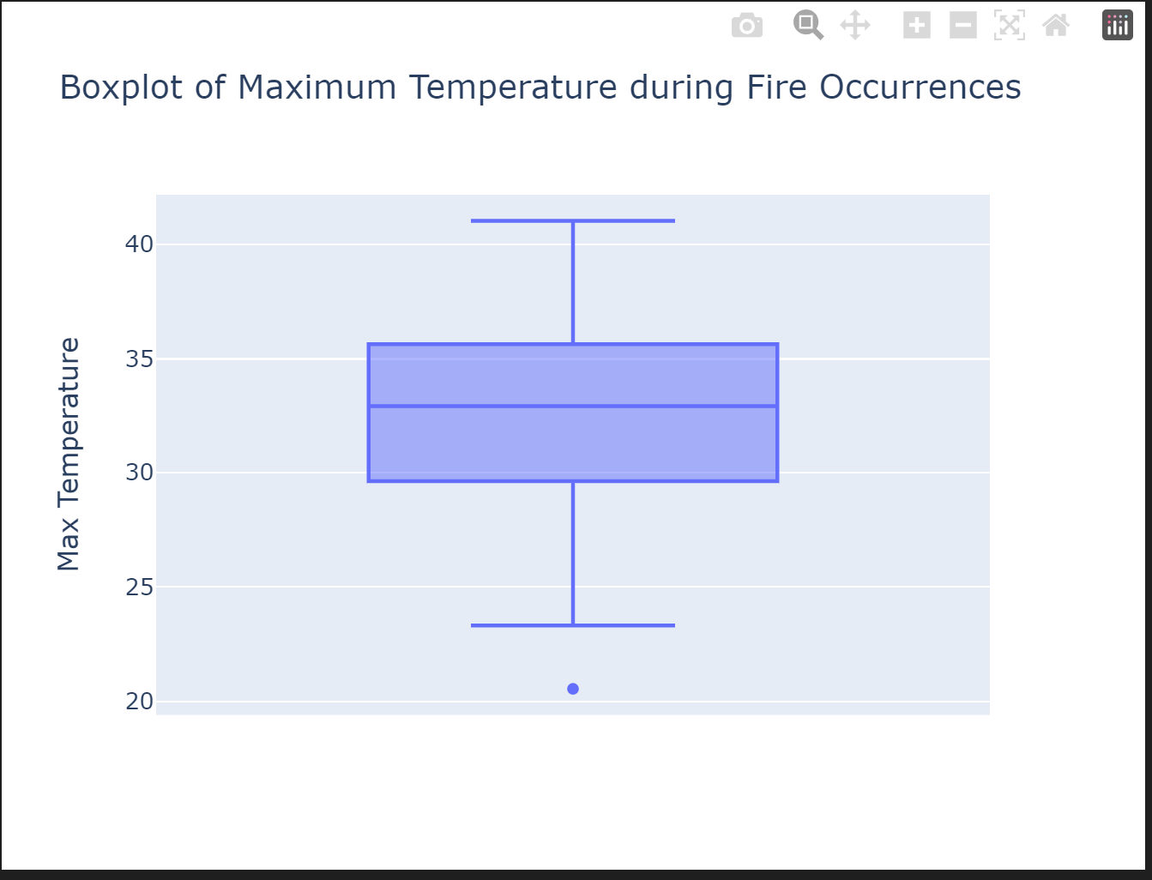
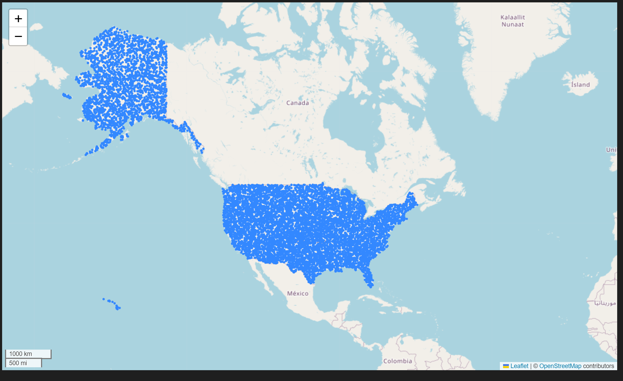
Temperature Box Plot and Random Points

Slide 13
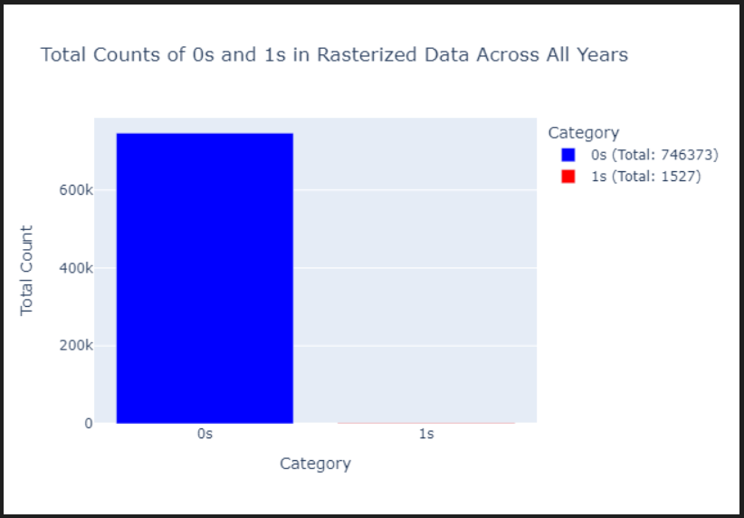
Data Imbalance

Slide 14
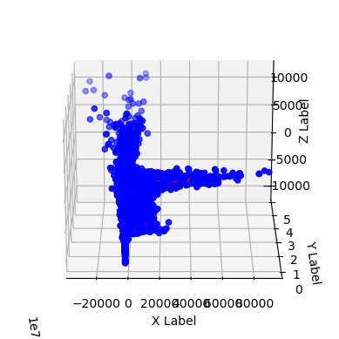
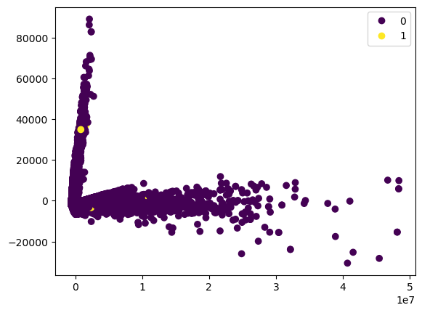
PCA 2D and 3D Visualization

Slide 15
Balancing the data
SMOTE (Synthetic Minority Over-sampling Technique):Enhances the representation of the minority class by creating synthetic examples rather than by oversampling with replacement. Widely used in machine learning to address class imbalance.
Geospatial Techniques for Data Balancing: Creates additional random points within fire polygons to increase the data points for areas with fires. Purpose is Mirrors the concept of SMOTE by enriching data representation in under-represented spatial areas.

Slide 16
Machine learning models
Random Forest
GridSearchCV
XGBoost
LGBM
SVC
ADABoost

Slide 17
Random Forest
Multiple Decision Trees (Robustness)
Feature Importance
Versatility in Data Types
Use Case:
It is used to build predictive models

Slide 18
Grid Search CV (GridSearchCV)
It is a technique for Hyper Parameter Tuning
GridSearchCV is a function that loops through predefined hypermeters to the best fit on training data
It uses cross validation
Use Case:
It is used to find the best Hyperparameters

Slide 19
XGBOOST
Model Performance
Handling of various Data Types
Regularization and overfitting control
Use Case:
It is well suited for Binary or multiclass classification problems

Slide 20
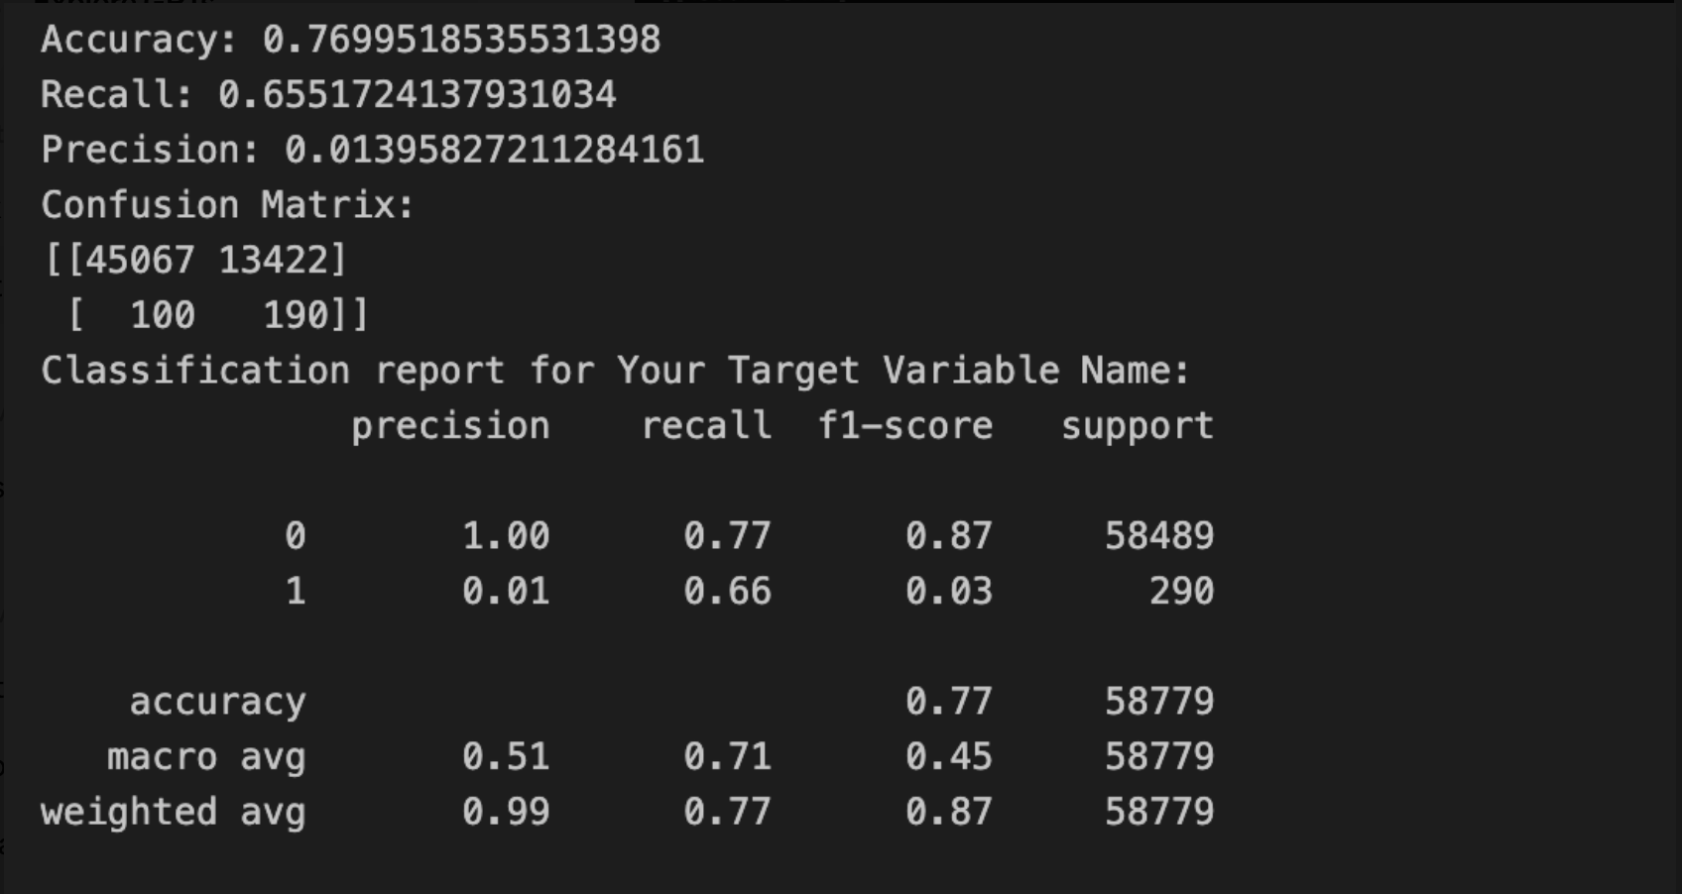
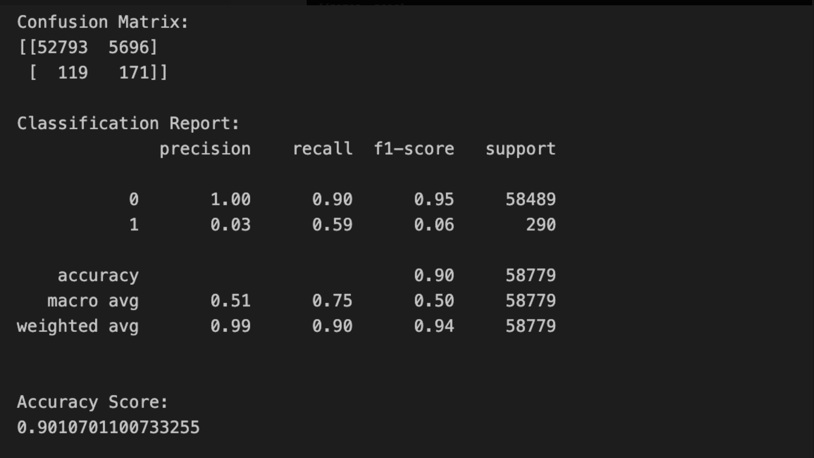
RandomForest

Slide 21
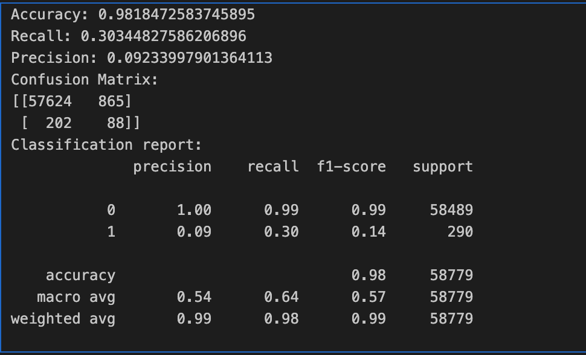
XGBoost

Slide 22
Model Comparisons
Model | Classification | Precision | Recall | f1-score | accuracy
Random Forest | 0 | 1 | 0.77 | 0.87 | 77
 | 1 | 0.01 | 0.66 | 0.03
XGBoost | 0 | 1 | 0.99 | 0.99 | 98
 | 1 | 0.09 | 0.3 | 0.14
LGBM | 0 | 1 | 0.97 | 0.98 | 96
 | 1 | 0.05 | 0.34 | 0.09
SVC | 0 | 1 | 0.9 | 0.95 | 90
 | 1 | 0.03 | 0.59 | 0.06
ADA Boost | 0 | 1 | 0.93 | 0.96 | 92
 | 1 | 0.02 | 0.31 | 0.04

Slide 23
Conclusions:
Random Forest is good in terms of prediction based on recall value.
Grid Search CV found best fitting parameters for Recall and f1-score.
XG Boost improves f1-score metrics by improving the False Negative Values.
Out of Random Forest, XGBoost, LGBM, SVC and ADABoost it found that Random Forest is the best model for this case with best recall metrics.

Slide 24
Further Improvements:
AWS Deployment for Real-Time Application
Workflow Automation with Apache Airflow
Vegetation Data
Human Intervention

Slide 25

References
https://journals.plos.org/plosone/article?id=10.1371/journal.pone.0254723
https://journals.plos.org/plosone/article?id=10.1371/journal.pone.0153589
https://geopandas.org/en/stable/docs/reference/api/geopandas.GeoSeries.sample_points.html
https://pygis.io/docs/d_vector_crs_intro.html
https://fireecology.springeropen.com/articles/10.1186/s42408-019-0062-8
https://www.mdpi.com/2571-6255/6/6/228

Slide 26
THANK YOU

